Slide 1
Team LFTCLK Game Concepts
By Abhijit Zala, Chris Fitch, Rohit Punjabi, and Vance Howald

Slide 2
Team Introduction
Producer and Audio: Chris
Engine Design: Vance
Graphics: Abhijit
Gameplay Programmer and Designer: Rohit

Slide 3
Main Concept
Zombie Apocalypse

Slide 4
Another “Fun” Concept
Bullet Hell Survival

Slide 5
And Yet Another Concept
Sidescrolling Survival

Slide 6
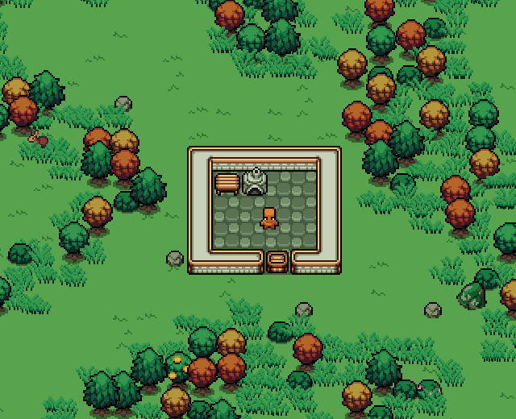
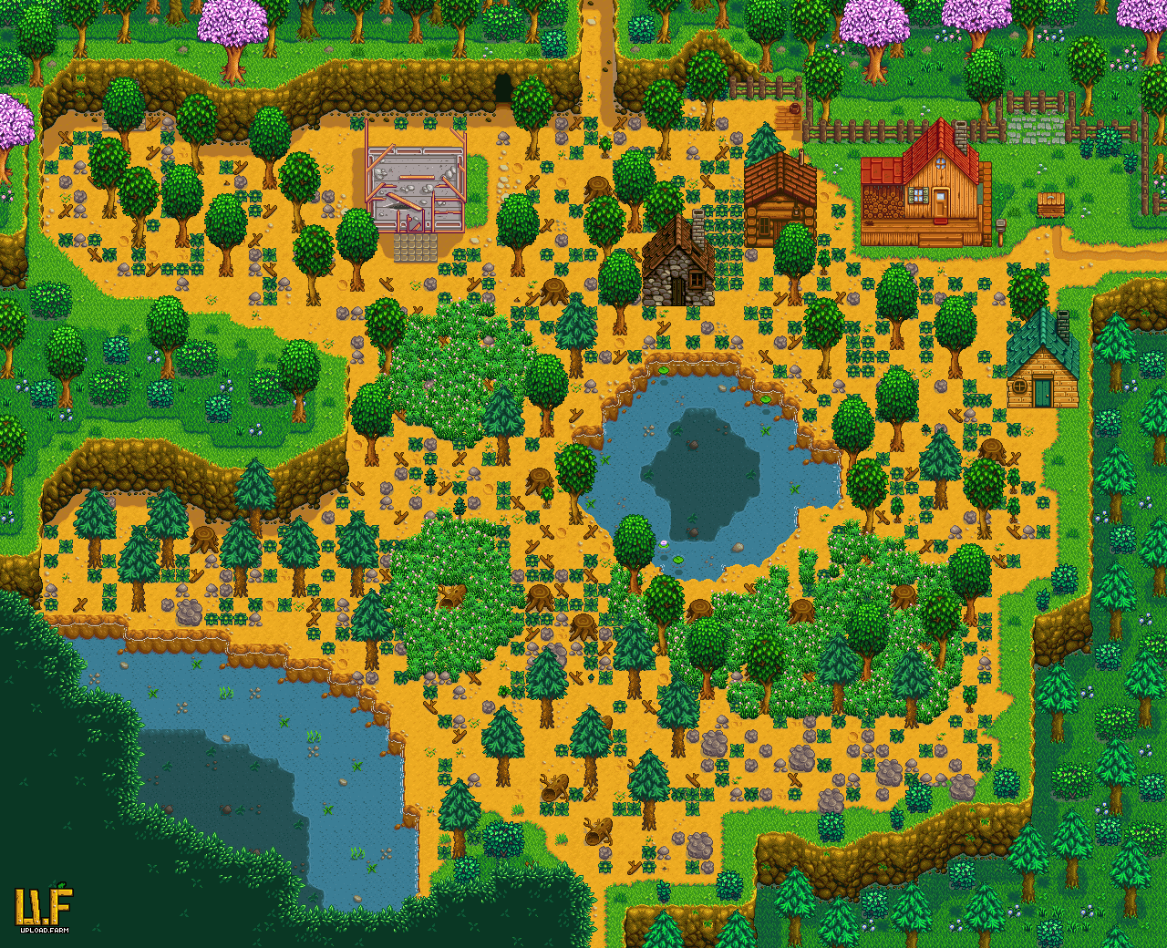
Setting

Slide 7
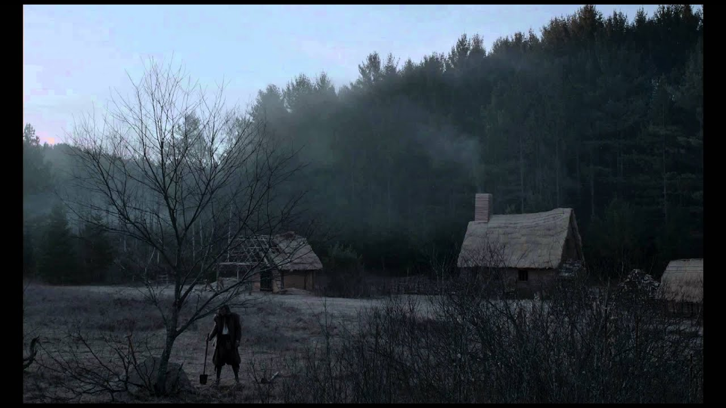
Core Mechanics:
Game flavor:
Exploration - Risk vs Reward
Survival
Game Phases:
Early game - COD Zombies survival
Mid-game - Exploration into forest for wood and upgrades
Late game - Overwhelmed

Slide 8
Core Mechanics:
Shooting
Multiple weapon upgrades.
High spray.
Movement
Routing around zombies for materials.

Slide 9
In Game Resources
Wood
Furniture inside the house.
Trees outside.
Upgrade Materials
Scattered outside of the house.

Slide 10
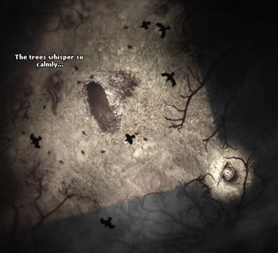
The Plan
TM
Focus on the important things first.
Creepy enemies.
Varied environment.
Spatial sound effects.
Focused lighting.
Creating a sense of anxiety.
Screenshot from Darkwood (2017)

Slide 11
The Plan
TM
If we have time…
Particle System for spooky deaths.
Attack power ups for the player.
Possibly better weapons.
Screenshot from Darkwood (2017)

Slide 12
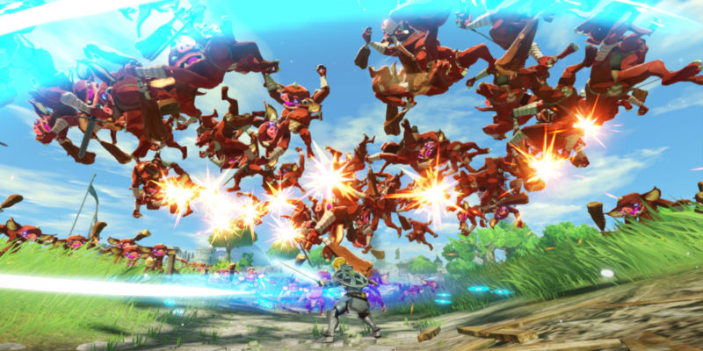
Risks: Performance Loss

Slide 13
Risks: Too Ambitious
This world might require a lot of mechanics to be fun.
It could be hard to make an engaging world with the time we have.

Slide 14
Mitigation: Too Ambitious
We need to make sure our base mechanics are engaging on their own

